Slide 1
The Essential Role of Creativity in Advertising

Slide 2
Do You Agree?
Conventional wisdom says that creativity is a key driver of successful advertising; that capturing the attention and imagination of the people is the most effective way to drum up engagement and sales.

Slide 3
What is creative advertising?
“[Creativity in advertising is] the extent to which an ad contains brand or executional elements that are different, novel, unusual, original, unique, etc.”

Slide 4


What is creative advertising?

Slide 5
Using creativity to stand out from the crowd
The first job of any ad is (and in fact, always has been) to stop a reader in their tracks.
We actually pay for products today by accepting an onslaught of tailored ads in return.
The biggest social platforms in the world are built on the promise of constant advertising.

Slide 6

Using creativity to stand out from the crowd
This is both a weapon and a weakness for advertisers. The weapon is that businesses can put their ads in front of more eyes than ever in history, all over the internet.

Slide 7
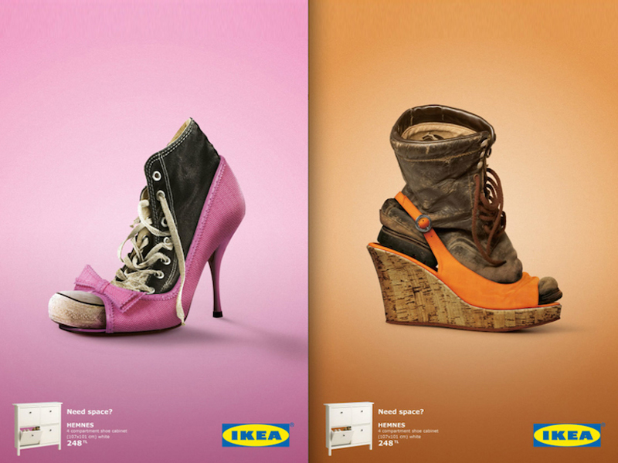
Using creativity to stand out from the crowd

Slide 8
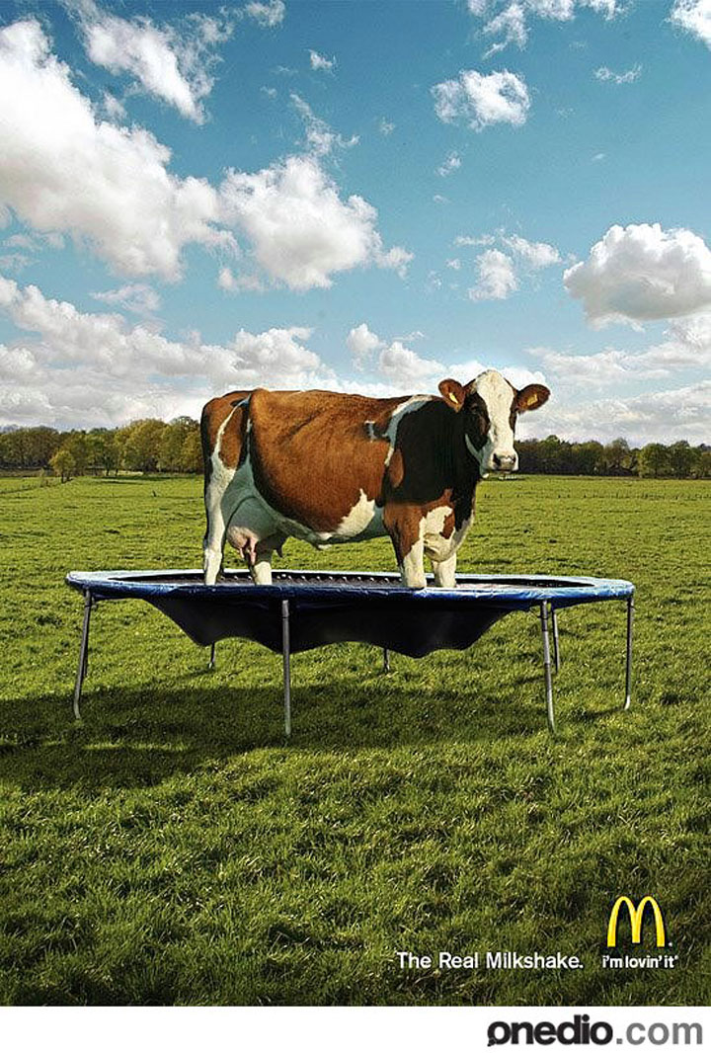
The self-perpetuating cycle of new ideas

Slide 9
The self-perpetuating cycle of new ideas
Creativity is how we unlock the new ways of standing out.
They’re rarely era-defining changes, but more often subtle and ongoing enhancements which help get eyes on ads.

Slide 10

The self-perpetuating cycle of new ideas

Slide 11
3 Major ways in which companies to breathe new life into their ads
Originality
Flexibility
Artistic value

Slide 12
Originality
Originality is about looking at what everyone else is doing and going in another direction.
This usually means building an ad with novel or surprising elements, an unusual viewpoint or ear-catching language.

Slide 13
Originality
It’s about subverting the customer’s expectations while still conveying the core message of your campaign.

Slide 14

Originality

Slide 15

Originality

Slide 16
Flexibility
Some products have a singular purpose.
Flexibility—seamlessly linking the product to the wide variety of uses, outcomes and benefits it has to offer.

Slide 17


Flexibility

Slide 18
Artistic Value
Adverts with high artistic value are a joy to the senses, containing highly appealing visual or verbal elements.

Slide 19
Artistic Value
As a rough guide point, there are 3 questions advertisers can ask themselves to assess if they’ve maximized artistic value:
Is the ad visually or verbally distinctive?
Does it make ideas come to life, either graphically or verbally?
Is it artistic in its production?

Slide 20
Artistic Value
Adverts with high artistic value are a joy to the senses, containing highly appealing visual or verbal elements.

Slide 21
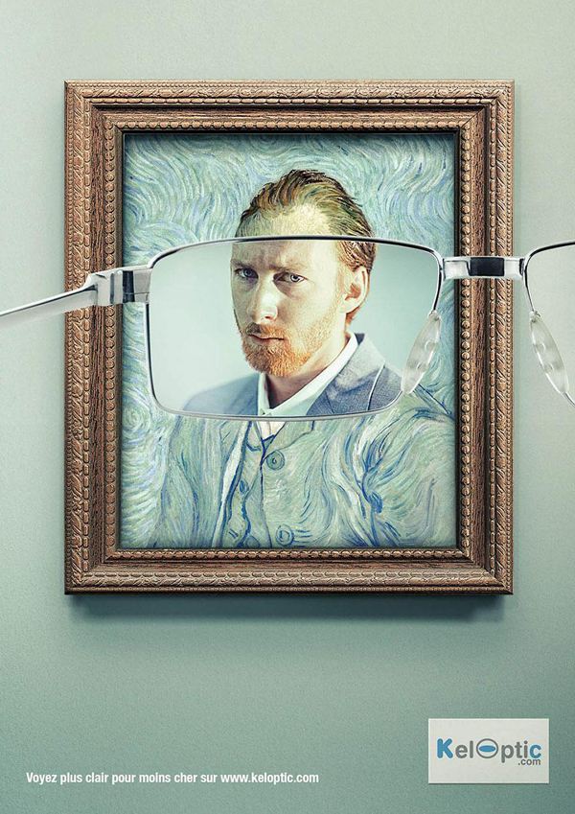
Artistic Value

Slide 22
Creativity is what makes ads memorable
All successful ads make an impression.
This isn’t the same as being seen: catching someone’s attention means you’ve stood out; staying in someone’s mind means you’re made an impression.

Slide 23
Creativity is what makes ads memorable
The key to being memorable is creating the message that resonates with prospects and engages them on an emotional level.

Slide 24
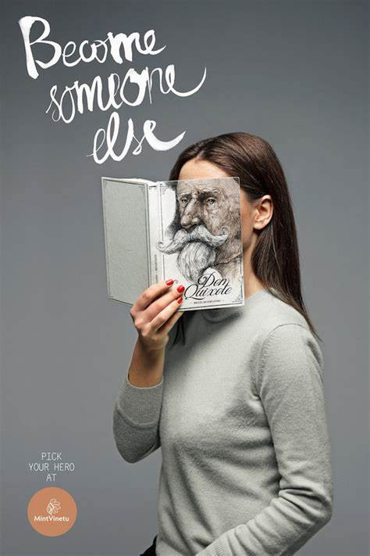

Creativity is what makes ads memorable

Slide 25
Creativity is what makes ads memorable
This is a different kind of creativity to making things “pop”. It requires a fundamental understanding of the customer, their pains, their motivations, where they are and what they want.

Slide 26

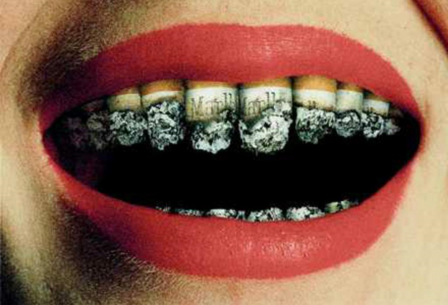
Creativity is what makes ads memorable

Slide 27
Finding a powerful message
Figuring out the most effective message for your target customer, and the best way to present that message, often requires creativity.
Many companies use surveys to get customer opinions and then build campaigns off this data.

Slide 28
Turning your message into a captivating story
Once you’ve found your message, you need to transform it into a powerful, resonant story.

Slide 29
How much creativity can you get away with?
As a rule, ads for highly-functional products need to focus more on the range of features and describe the factual use of the product.
Otherwise, they run the risk of confusing prospects and failing to convey how the product will impact their lives.

Slide 30
How much creativity can you get away with?
Coffee adverts, for example, have spanned everything from celebrities on terraces to wild, emotional journeys across the world—ending with the sumptuous sensation of hot coffee.

Slide 31


How much creativity can you get away with?

Slide 32
How much creativity can you get away with?
Once again, knowing what level of creativity companies can safely exert depends on knowing the target audience.

Slide 33
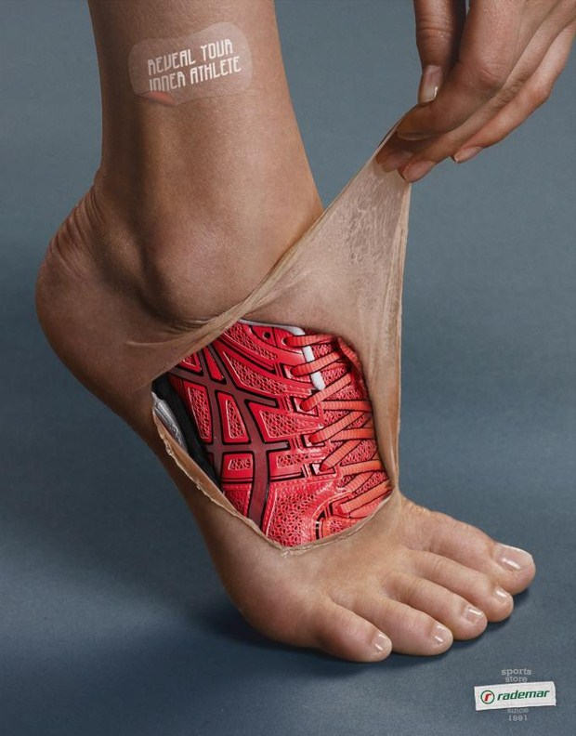
How much creativity can you get away with?

Slide 34
Conclusion
It requires a lot of work and constant challenging of the status quo to create consistently creative ads, but the reward for doing so is established and proven—they’re simply more persuasive and more effective than non-creative ads!

